Slide 1



MSc Data Science and Artificial Intelligence University Of Liverpool
Module: CSCK542 Databases and Information Systems
University Record Management System
Design & Implementation
End of Module Assignment Demonstration
By Group D
Kyle Walid
Hiu Yan Li
Gabriel Andino
Joyce Adikini

Slide 2
University Record Management System
Introduction
Welcome to our presentation on the design and implementation of a University Record Management System. This project was developed for the CSCK542 Databases and Information Systems module and demonstrates the design, implementation, testing, and evaluation of a database-driven application.

Slide 3
University Record Management System
Project Overview
Objectives
Design a university record management database
Provide user interfaces for querying records
Implement at least five SQL queries
Populate the database with realistic test data
Final Solution
20 normalised tables
~400 seed records
9 parameterised queries
GUI and CLI Interfaces
SQLite and MySQL backends
110 automated tests
The objective was to design and implement a database system capable of managing university records, including students, lecturers, courses, departments, programmes, and research activities. The final solution exceeded the brief by implementing nine queries, two interfaces, dual database support, and a comprehensive testing framework.

Slide 4
University Record Management System
Database Design 1 - 2MINS
DATABASE DESIGN
Database Design

Slide 5
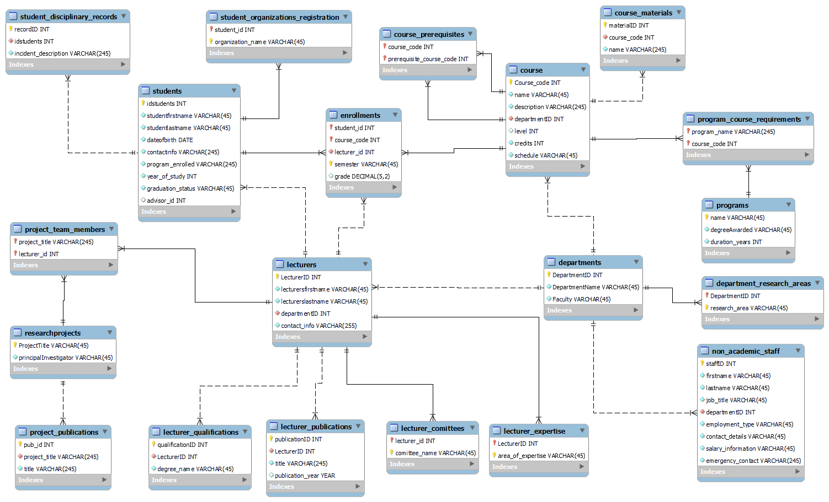
University Record Management System
Database Design - University System ERD
20 normalised tables
Designed in MySQL Workbench
Surrogate DepartmentID key
Multi-valued data modelled through related tables
Student-Course relationship resolved by enrollments

Slide 6
University Record Management System
Database Design
ERD Explanation
This slide shows the Entity Relationship Diagram for the University Record Management System. The database consists of 20 normalised tables designed in MySQL Workbench.
To reduce redundancy and maintain data integrity, multi-valued information such as qualifications, expertise areas, publications and disciplinary records was modelled using separate related tables.
The many-to-many relationship between students and courses is resolved through the enrolments table, which also stores semester and grade information. During development, a surrogate DepartmentID key was introduced to improve referential integrity and provide consistent relationships between departments, lecturers, staff and courses..

Slide 7
University Record Management System
Key Design Decisions 1 - 2MINS
Important Decisions
Surrogate DepartmentID key
Numeric nullable grades
Layered architecture
Query catalogue
SQLite + MySQL support
Several design decisions significantly improved the system. Department relationships were standardised through a surrogate key, grade values were stored as numeric nullable attributes to support aggregation, and all queries were managed through a shared catalogue. The system also supports both SQLite and MySQL through a single database abstraction layer.

Slide 8
University Record Management System
System Architecture 30 to 60 sec
Layered Architecture
GUI (Tkinter) and CLI interfaces
Shared query engine (queries.py)
Database abstraction layer (db.py)
SQLite and MySQL support
Benefits
Separation of concerns
Easier maintenance
Reusable query logic
Supports multiple front ends
The application was organised into three layers. The GUI and command-line interfaces contain no SQL, the query engine contains no user-interface code, and the database layer is responsible for communicating with either SQLite or MySQL. This separation allowed the schema and interfaces to evolve independently throughout development.

Slide 9
University Record Management System
Database Design 1 - 2MINS
QUERY INTERFACES
1. Standard query interface
2. Custom query builder interface
Database Design

Slide 10
University Record Management System
Live application demo 4 to 5 mins
Query Interfaces
Standard query interface
Custom query builder interface
The graphical interface provides access to predefined queries and a custom query builder. Parameter values are populated dynamically from the database through dropdown menus, and related fields cascade automatically. For example, selecting a course filters the list of lecturers to those associated with that course.

Slide 11
University Record Management System
Live application demo 4 to 5 mins
Query Demonstration
Students enrolled in a course
Students above the grade threshold
Students not registered
Advisor details
Lecturer expertise
The system implements nine parameterised queries. These queries demonstrate joins, aggregation, subqueries, filtering and relationship traversal across the database.

Slide 12
University Record Management System
Security and Testing Unit test – 1 min
Security
Parameter binding
Identifier whitelist
Testing110 unit tests
GUI tests
CLI tests
Query tests
Data integrity tests
Security was addressed using parameterised queries and a controlled whitelist of tables and columns. Automated testing covers every major module within the application, including the query engine, interfaces, database layer, and query builder. The full test suite executes in approximately half a second.

Slide 13
University Record Management System
Layered design
Dual database support
Query builder
Strong test coverage
Strengths
Limitation
Teaching is currently derived from enrolments
Course-Lecturer assignment table
Authentication
Role-based access
Report generation
Web deployment
Future Work

Slide 14
University Record Management System
Project outcome – 30 sec
Project Outcomes
✅ Normalised university database
✅ Dual SQLite/MySQL support
✅ GUI and CLI interfaces
✅ 9 parameterised queries
✅ Successful testing and UAT
In conclusion, the project successfully delivered a normalised university record management system that satisfies and exceeds the assignment requirements. The combination of strong database design, layered architecture, automated testing, and dual database support provides a solid foundation for future expansion into a multi-user production system.

Slide 15
University Record Management System
References
Codd, E.F. (1970) 'A relational model of data for large shared data banks', Communications of the ACM, 13(6), pp. 377–387. Available at: https://web.eecs.umich.edu/~michjc/eecs584/Papers/codd_1970.pdf (Accessed: 20 July 2026).
European Parliament and Council of the European Union (2016) Regulation (EU) 2016/679 (General Data Protection Regulation). Available at: https://eur-lex.europa.eu/legal-content/EN/TXT/PDF/?uri=CELEX:32016R0679 (Accessed: 20 July 2026).
Kishansing, D.G. and Suthar, S.M. (2014) 'Study of the ANSI/SPARC architecture', International Journal of Modern Trends in Engineering and Research, 1(3). Available at: https://www.scispace.com/pdf/study-of-the-ansi-sparc-architecture-2r4jhs6alz.pdf (Accessed: 20 July 2026).
Lemburg, M.-A. (2001) PEP 249 – Python Database API Specification v2.0. Python Software Foundation. Available at: https://peps.python.org/pep-0249/ (Accessed: 20 July 2026).
OWASP Foundation (no date) SQL injection prevention cheat sheet. Available at: https://cheatsheetseries.owasp.org/cheatsheets/SQL_Injection_Prevention_Cheat_Sheet.html (Accessed: 20 July 2026).
Ries, E. (no date) What is an MVP? Eric Ries explains. Lean Startup Co. Available at: https://leanstartup.co/resources/articles/what-is-an-mvp/ (Accessed: 20 July 2026).
van Rossum, G., Warsaw, B. and Coghlan, A. (2001) PEP 8 – Style Guide for Python Code. Python Software Foundation. Available at: https://peps.python.org/pep-0008/ (Accessed: 20 July 2026).

